Slide 1
Business Analysis
Credit Card
Risk & Opportunities
Nicolás Japas, Jose Muñoz Alvis, Mubarik Ibrahim

Slide 2
Who Accepts the Card?
18000
Observations
5%
Accepted
Client Characteristics
Customer Number
Offer Accepted, Reward
Mailer Type
Income Level
Number of Bank Accounts Open
Overdraft Protection
Credit Rating
Number of Credit Cards Held
Number of Homes Owned
Household Size
Own Your Home
General Average Account Balance,
Average Account balance over
Q1, Q2, Q3 and Q4.

Slide 3
01
02
03
04
DATA
EXPLORATION
DATA
PROCESSING
BUILDING
MODEL
VALIDATING RESULTS
Tableau
SQL
Python
Pandas
Numpy
Random Forest
Decision Tree
KNN
Logistic Regression
ROC-AUC
Confusion Matrix

Slide 4

WHICH ARE THE FEATURES OF OUR CLIENTS?
INCOME LEVEL
MAILER TYPE
REWARD
Low and medium income less cash
Low and medium income - postcards
Accumulation
Projection

Slide 5
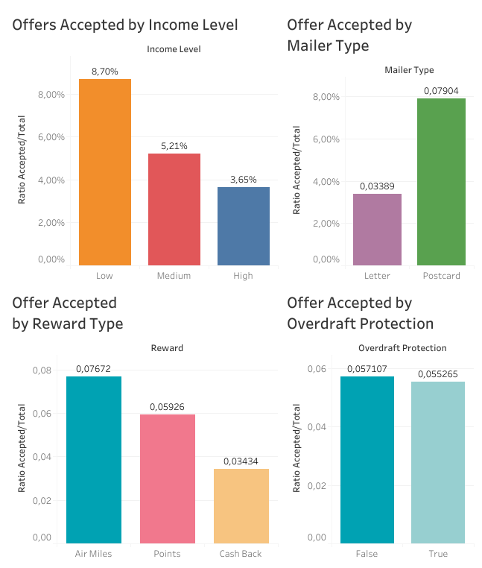
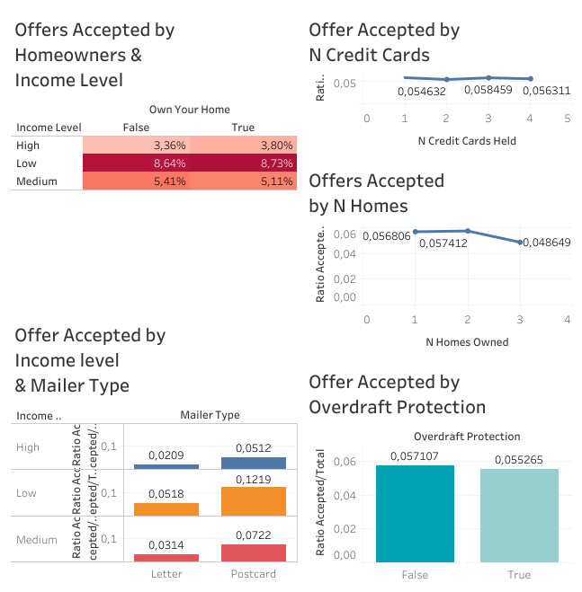
WHICH ARE THE OPPORTUNITIES?
TARGET
REWARD
CONTACT
Homeowners with
low and medium income level
Diversify reward for medium and high income
New strategies for
clients with high income level

Slide 6

DATA PROCESSING & BUILDING THE MODEL
Logistic Regression
KNN
Random Forest Decision Tree

Slide 7
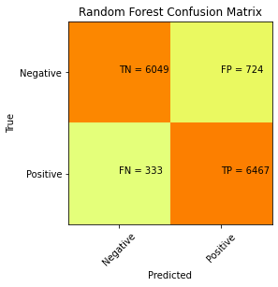

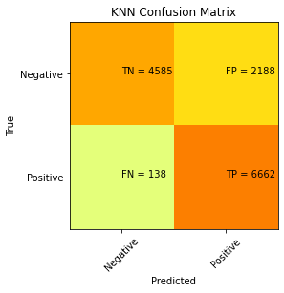

MODEL PERFORMANCE
CONFUSION MATRIX
RANDOM FOREST
KNN
DECISION
TREE
LOGISTIC REGRESSION

Slide 8
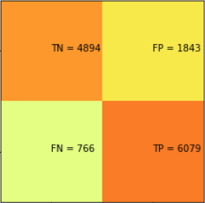
VALIDATION WITH MINIMAL SET
+80% ACCURACY!
RANDOM FOREST MINIMAL SET 3 FEATURES
INCOME LEVEL
+
MAILER TYPE
+
REWARD

Slide 9
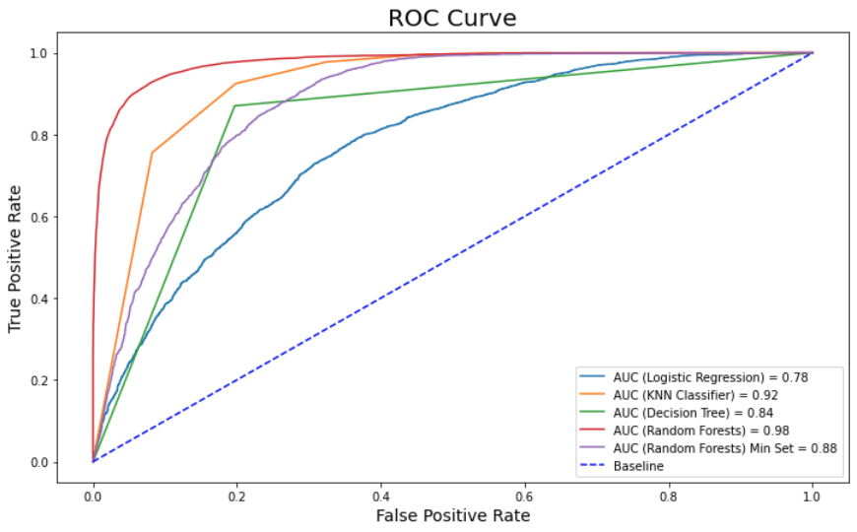
ROC AUC

Slide 10
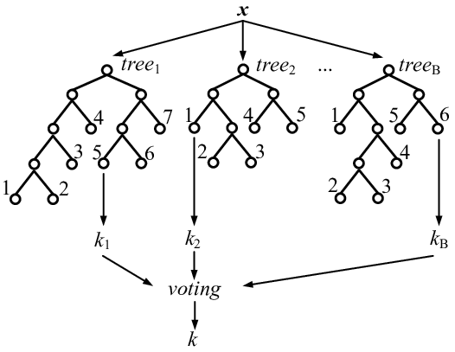
RANDOM FOREST FOR THE WIN!

Slide 11
Why is this information valuable?
Credit Card offers issuing is somewhat expensive
Therefore maximizing positive response rate decreases spending while increases profits

